Slide 1

TWITTER SENTIMENT ANALYSIS
Aruna Singh

Slide 2

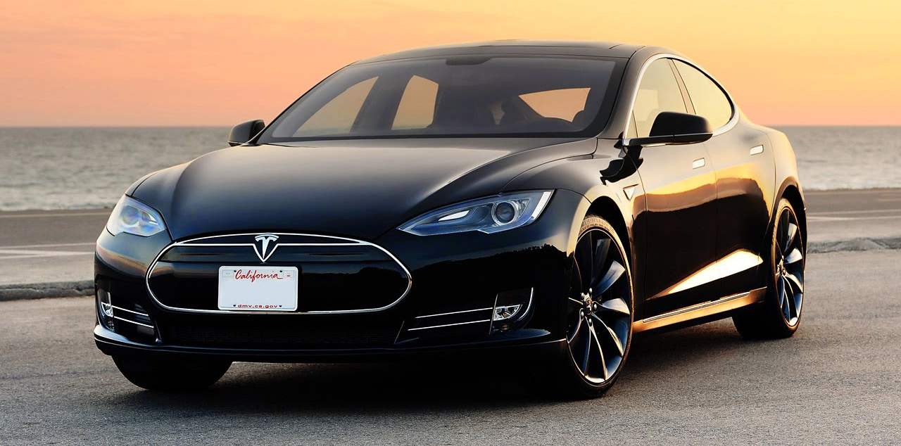
OBJECTIVE
Analyze the Sentiment of Tesla and Churchill Capital to determine how Twitter sentiment affects stock price and decide if action is needed for Tesla to maintain its share of the EV market
MOTIVATION
Churchill Capital recently acquired Lucid Motors (EV company). This puts Churchill Capital in position to complete in the EV Market.
METHOD
Sentiment Analysis with Natural Language Processing

Slide 3


SENTIMENT ANALYSIS
An Application of Natural Language Processing
Used to identify the emotion in human language
Can be applied to social media for public opinion insights
Use Cases:
Marketing Analytics & Brand Management
Financial Analysis
Application Support
Notes:
Sentiment analysis uses Natural Language Processing (NLP) to make sense of human language, and machine learning to automatically deliver accurate results.

Slide 4


Companies and background
Tela Leads the market ($795.8 Billion)
Competitors have been slow to compete
Technology
Price
Supply Chain
Churchill Capital has emerged as a competitor (Lucid Motors)
Electronic Vehicle (EV) market is predicted to grow rapidly
Notes:
You can add more here!

Slide 5
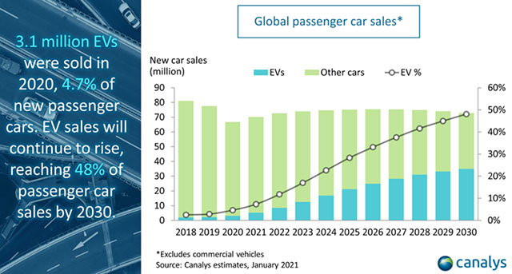
Electronic Vehicle Market Growth

Slide 6
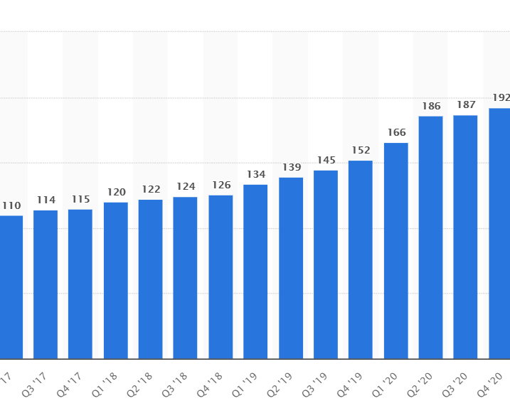
Twitter data is high volume, velocity and Variety

Slide 7

Challenges & Limitations
Tweets containing both ‘tesla’ and ‘cciv’
Keywords in links and hashtags were ignored
Limited Training data available for positive and negative sentiment
Prefer manual labelling
TextBlob categorization model used to create training data contained error
Sarcasm and other unusual jargon difficult to analyze
API limitations (3200 requests / 15 minutes)
Notes:
You can add more here!

Slide 8
DATA PREPARATION
ACQUISITION
CLEANING
LABELING

Slide 9

Data Acquisition
TWEEPY
An open-source python library
All the functionality provided by Twitter API
OAuth authentication
Used api.search() with query, retweet filter and extended mode.
Returns dictionary object
Fetched everyday

Slide 10
DATA CLEANING
LOWERCASE
REGULAR EXPRESSION
CSV FILE

Slide 11

SENTIMENT LABELING
TEXTBLOB
Simple Python library
Uses rule-based approach
Gives polarity sentiment to tweets
Ideally should have human involvement

Slide 12

SUPPORT VECTOR MACHINES
Supervised machine learning algorithm
Performs classification by hyperplanes in n-dimension.
In our case Kernel is linear.
Transform data into vectors : TfidfVectorizer
Scikit Learn
Open Source
Python Library
Powerful tool for ML algorithms.
Notes:
Sentiment analysis uses Natural Language Processing (NLP) to make sense of human language, and machine learning to automatically deliver accurate results.

Slide 13
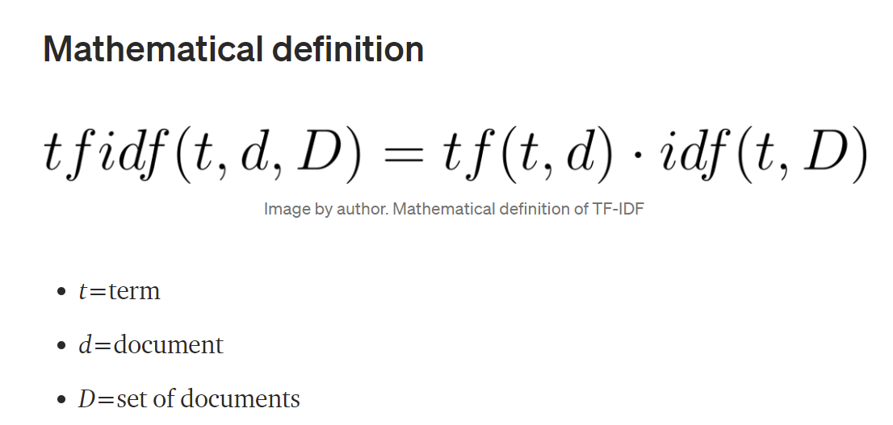
TFIDF VECTORIZER
TF-IDF defines relevance of a term.
Takes into consideration the importance in a single document and scales it by its importance across all documents.
Notes:
Sentiment analysis uses Natural Language Processing (NLP) to make sense of human language, and machine learning to automatically deliver accurate results.

Slide 14
IMPLEMENTATION
Removed the stop words .
Used TFIDF vectorizer on our training dataset to extract the features.
These features are then used to vectorize our test data set.
Both the vectors are then used to obtain the predicted labels using the SVC classify function of Scikit-learn.
Notes:
Sentiment analysis uses Natural Language Processing (NLP) to make sense of human language, and machine learning to automatically deliver accurate results.

Slide 15
Results – Confusion matrix
Predicted
Confusion Matrix
Classifies the tweets into positive and negative sentiments
Displays the number of positive and negative predictions acquired from the classification models in comparison with the actual counts
662 | 188
315 | 115
Actual
Notes:
classification_report

Slide 16
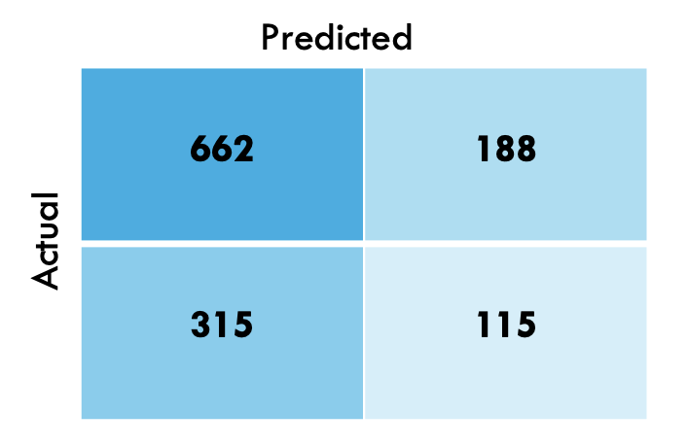
Results – CLASSIFication report
Precision
Measures how good the classifier is classifying tweets as positive sentiment.
Recall
Measures how good the classifier is at correctly classifying tweets as negative sentiment
F1 score
A metric that combines the trade-offs of precision and recall
Accuracy
The proportion of the total number of predictions that were correct
Notes:
classification_report

Slide 17
Visualizations - wordcloud
Creating sentiments eye candy
Simplify data for comparison and categorization
Quickening business actions
Visualize the positive and negative wordcloud out of the sentiment score
Notes:
You can add more here!

Slide 18
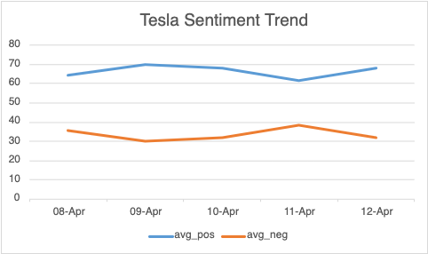
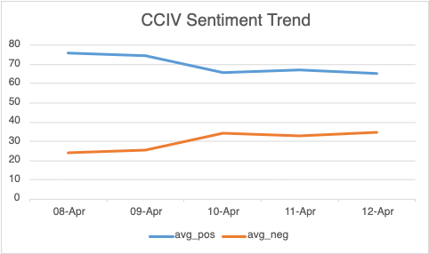
Correlation between sentiments and stock price variation
The average positive sentiments are rising for Tesla while negative for CCIV on the daily basis

Slide 19
Correlation between sentiments and stock price variation
Stock price variation for Tesla and CCIV in the same range
It’s clear that the Twitter sentiment and stock price are correlated during a week

Slide 20

Extensions
Further Analysis
Pull data from more data sources. i.e. Reddit
Develop training set manually and specific to Tesla, CCIV, and EV language
Sentiment Analysis Applications
Monitor Product Release
Natural Language Processing (NLP) Applications
Content Categorization
Speech-to-Text (vice versa) conversion
Document Summarization & Contextual Extraction
Market Research
Identify Customer Trends
Brand Management
Act to improve reputation

Slide 21
takeaways
Establish clear vision for business application of the project
Extensive technology research before deciding on stack
Technology selected for quick implementation and simplicity
Research available algorithms and prior implementations
No need to reinvent the wheel
Fine tune the model and spend daily time with the data
Develop a regular meeting time with your client
Make aware of issues when identified
Use Guidance wisely
Have Patience!!!
Notes:
You can add more here!

Slide 22




Thank You

